Slide 1
New Physics Beyond SM: An Introduction
标准模型取得了巨大成功，
但它不是一个基本的理论，
有一些理论问题无法解释

Slide 2
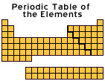

New physics beyond SM certainly exists
Finetuning

Slide 3
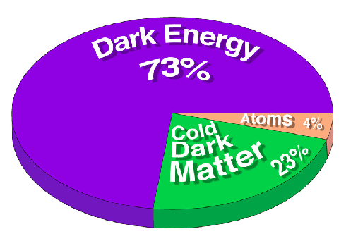
问题1：暗物质和暗能量

Slide 4
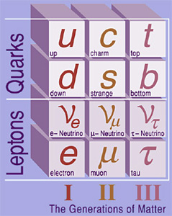
问题2：费米子代和味道之谜
为什么恰好有三代 ？
为什么有不同的质量?
CP 破坏问题

Slide 5
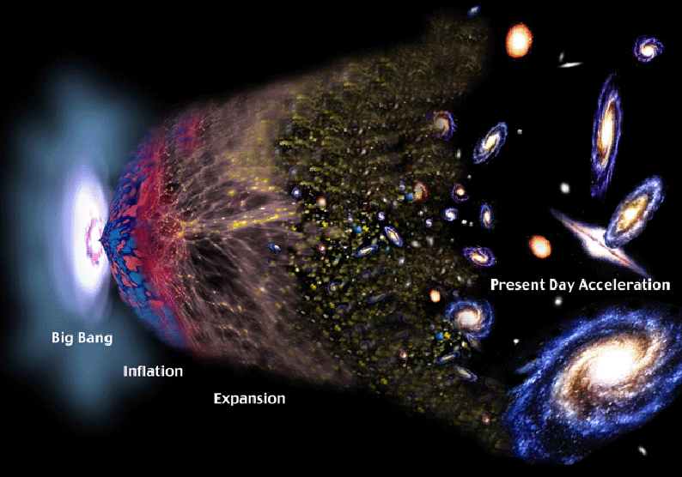
问题3：物质和反物质不对称问题

Slide 6
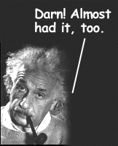
问题4：大统一
基本粒子物理的一个主要目标就是把各种作用力统一起来
---大统一理论
爱因斯坦晚年致力于把电磁力和引力统一起来,但没有成功
至今，人们仍在探索大统一理论

Slide 7
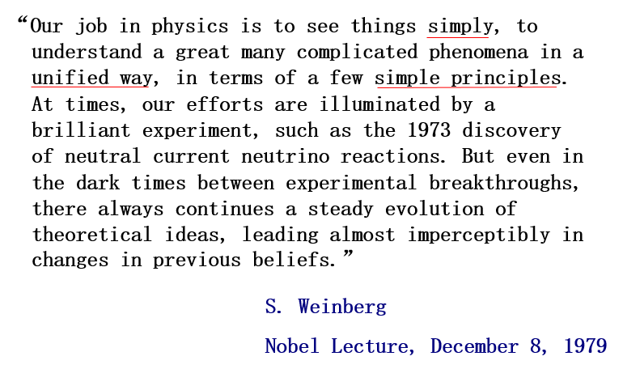

Slide 8
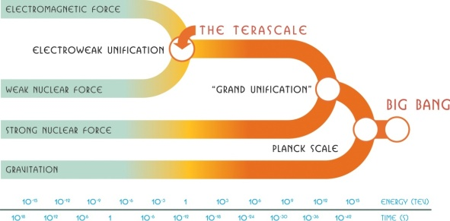

Slide 9
问题5：精细调节问题
黑格斯质量的平方发散：

Slide 10
10/42

Slide 12
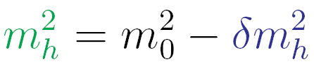
If SM valid up to GUT scale, the theory
has extreme fine-tuning !
10¹⁵ GeV
大统一
100 GeV
参数
Λ² /52
在地球上拿枪瞄准月球上的一只兔子
在光滑的镜面上竖立起一根很尖的针
∼1 TeV
新物理
1693年，牛顿
回答‘引力定律怎样跟静态宇宙自洽’：
∼100 GeV
标准模型

Slide 13
The naturalness problem is that the mass of a fundamental scalar is quadratically sensitive to high energy thresholds
This is a statement about renormalized quantities and has nothing to do with the regularization method used.
We can see this from a toy model that is a Yukawa type theory with two scalars and a fermion：

Slide 14
Using dimensional regularization and the MS renormalization scheme, we obtain at one loop

Slide 15
Thus, scalar masses are unstable, quadratically sensitive to higher energy thresholds whereas fermion masses are stable against radiative
corrections since they are protected by a symmetry.
To see this, we consider
15/42

Slide 16
‘t Hooft Doctrine of Naturalness
G.'t Hooft: in Recent Developments in Field Theories, ed. G.'t Hooft et al., Plenum Press, New York, 1980, page 135.

Slide 17
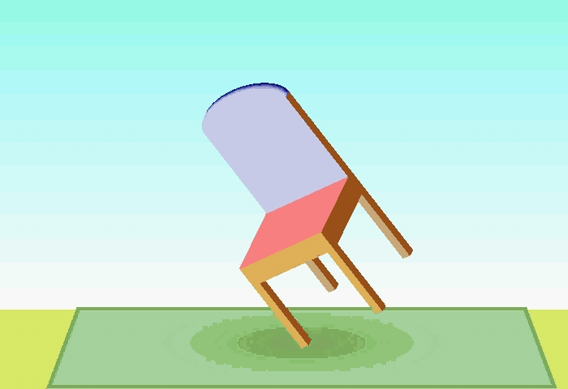
Gerard ’t Hooft,
Beijing
Feb 25, 2014

Slide 18
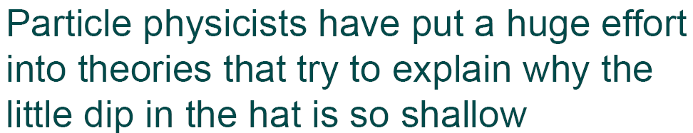
Edward Witten
Hunter College
Mar 4, 2013

Slide 19

Savas Dimopoulos
Beijing
Feb 24, 2014

Slide 20
20/42

Slide 22
W and Z contribution to proton and neutron mass
Stuart Samuel
hep-ph/9910559

Slide 23
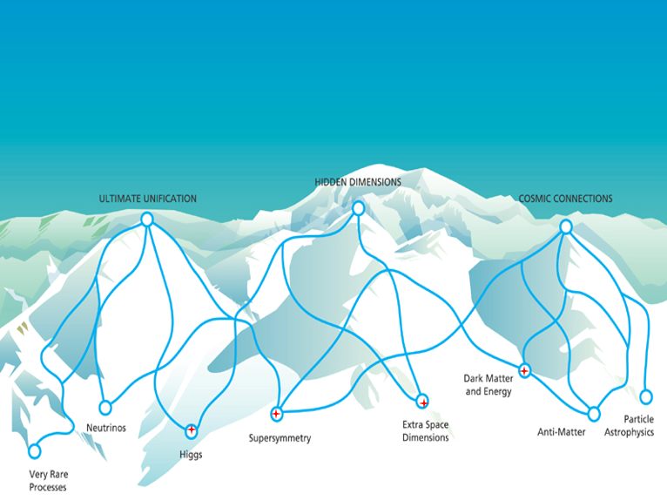
三座大山

Slide 24
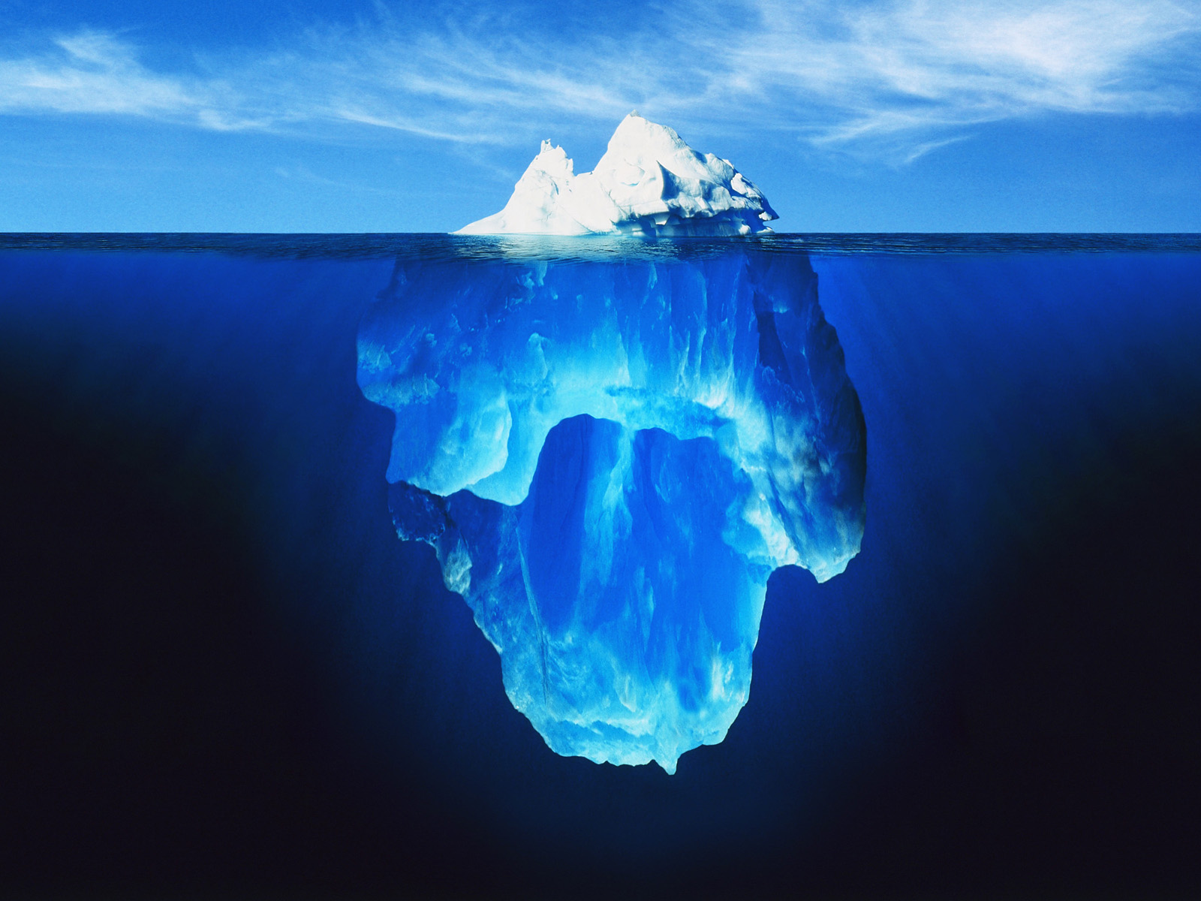
标准模型
新物理

Slide 25



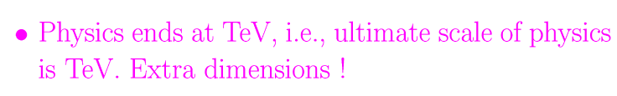
25/42
Possible New Physics
to Solve Finetuning Problem
Little Higgs !

Slide 26
Murayama
SUSY-2016
It’s striking that we’ve thought about these things for 30 years and we have not made one correct prediction that they have seen.

Slide 28
实验家
实验家
理论家
实验家

Slide 29
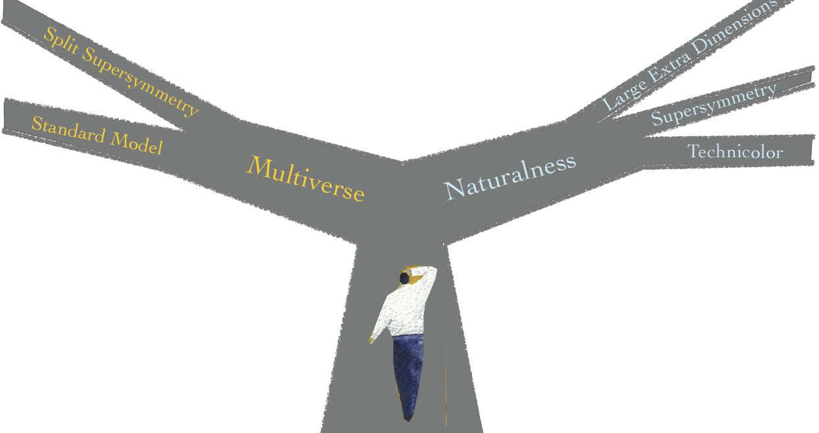
Savas Dimopoulos
Beijing
Feb 24, 2014

Slide 30
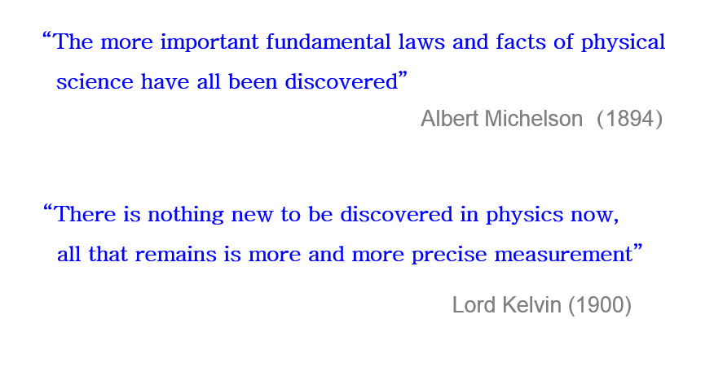
30/42

Slide 31
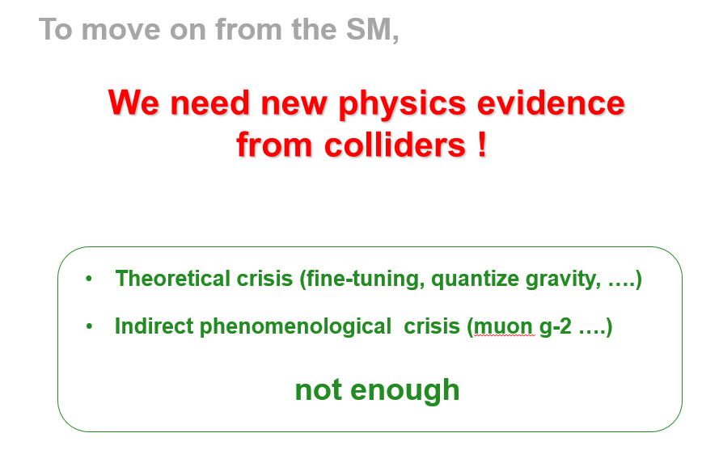

Slide 32
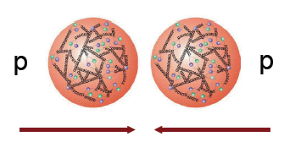
The current LHC data

Slide 33

LHC 最大的功劳 — 发现了黑格斯粒子
François Englert
Peter W. Higgs

Slide 34
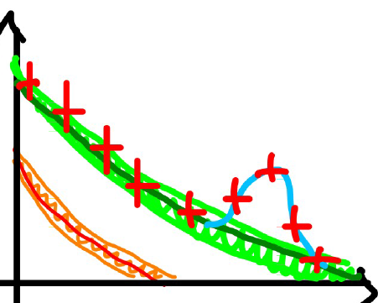
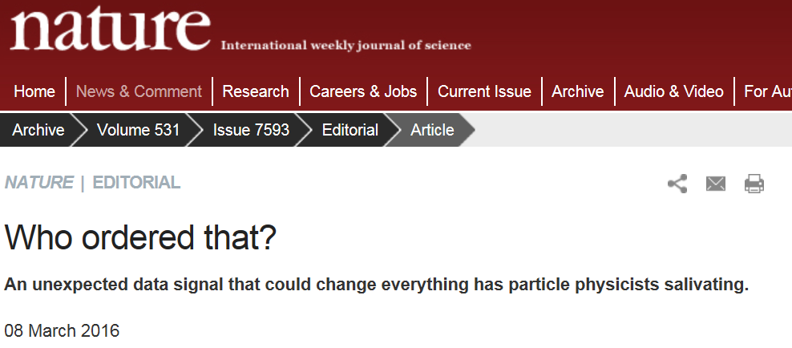
LHC 最大的玩笑 — 750 双光子超出
The LHC is now providing the opportunity
of a lifetime to break entirely new ground.

Slide 35
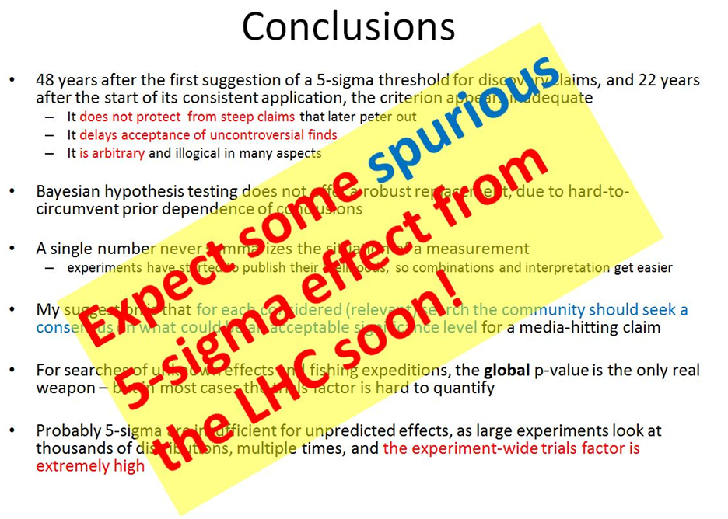

35/42
Note:

Slide 36
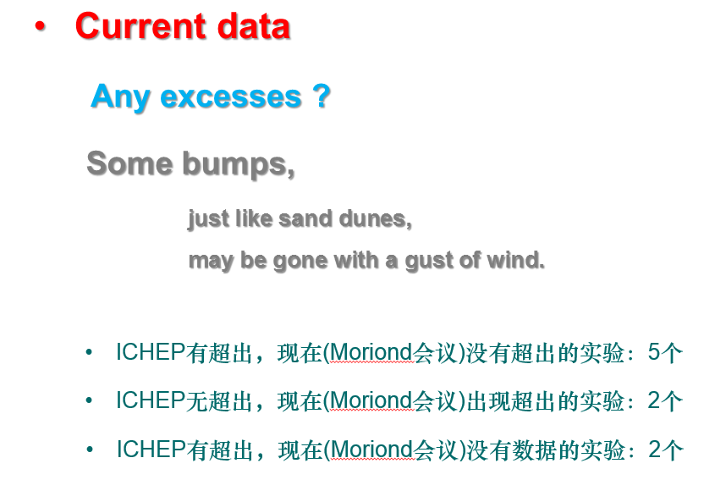

Slide 37
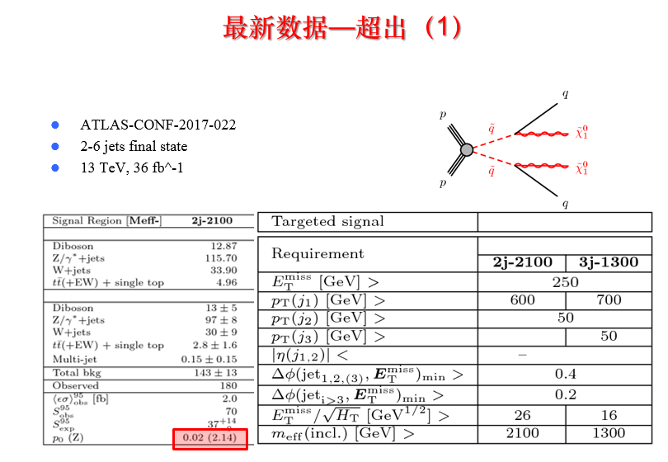

Slide 38
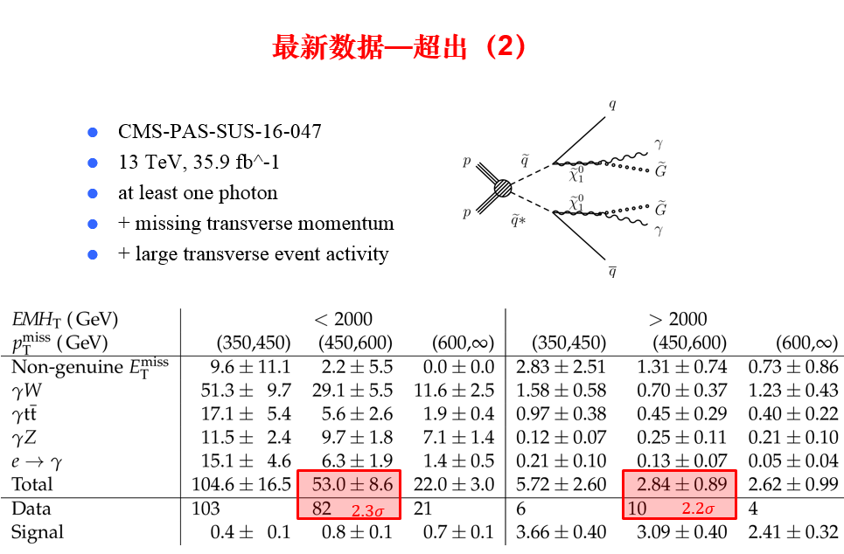

Slide 39
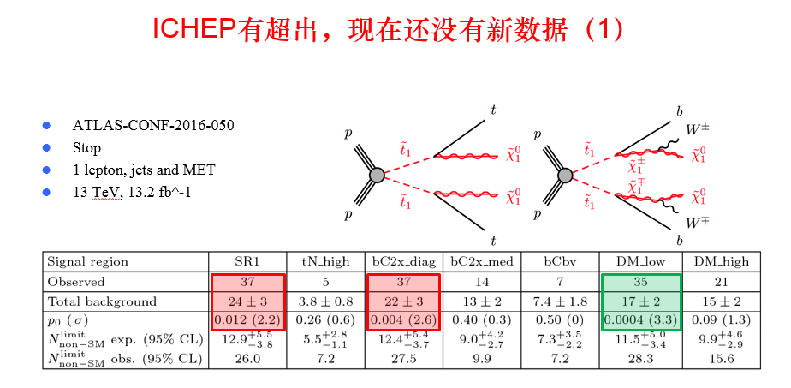
40/42

Slide 40
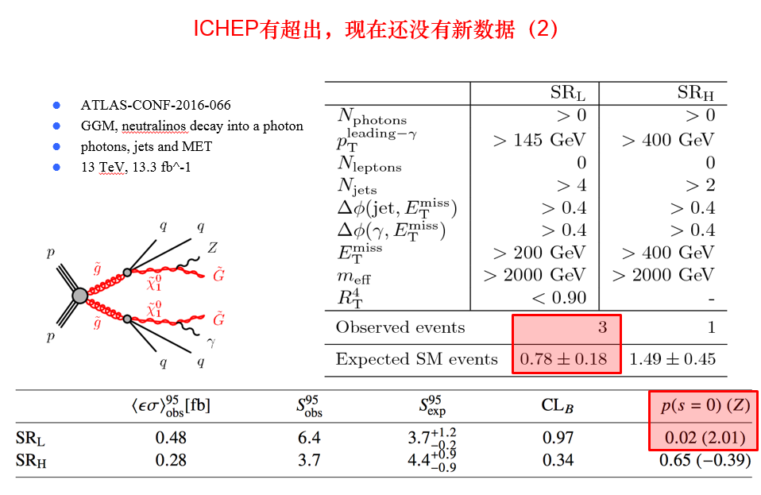

Slide 41
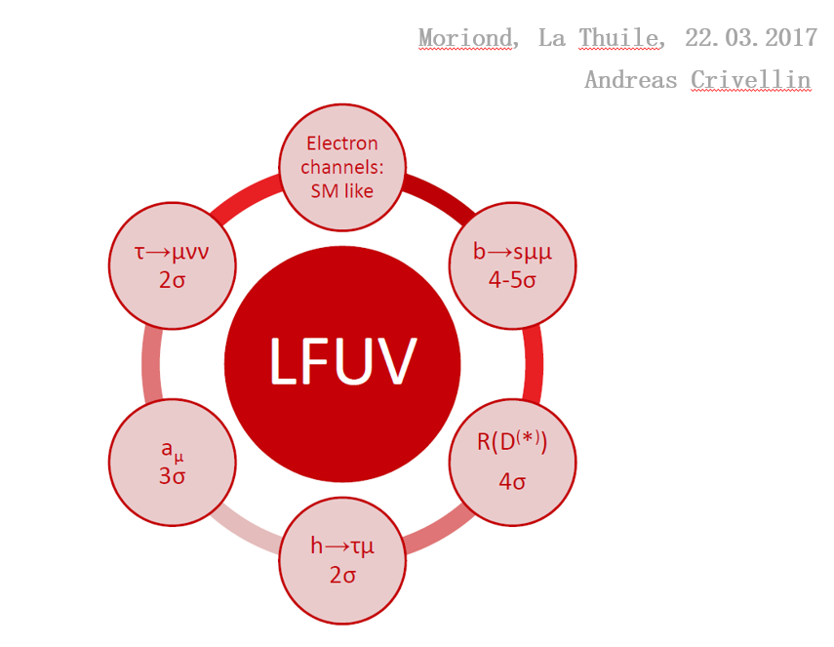
41/42

Slide 42
J. Ellis
SUSY2013

